Slide 1

Theory and practice of translation

Slide 2
What is translation?
Translation is a rendering from one language into another; also : the product of such a rendering (Merriam-Webster’s Dictionary)
Translation may be defined as a means of interlingual communication which renders meaning across cultures (А. Л. Бурак, 2002).
Translation is the process and result of creating a text in a target, or translating, language (TL); this text has approximately the same communicative value as the corresponding text in the source language (SL). Ibid.

Slide 3
Translation and Communicative Theory
A communicative act has three dimensions:
In the process of translation this scheme becomes more complicated:
Appearance of a translator raises the problem of adequacy and equivalence of the process of rendering.
Speaker
MESSAGE
Audience
Speaker
MESSAGE
Translator
MESSAGE
Audience

Slide 4
Translation as a communicative act deals with codes – a system of signs and rules of their combination which is designed for rendering a message.
Linguistic units (sounds, letters, syllables, words, phrases) make a communicative channel between a speaker and a recipient.
Language is a code of verbal exchanging of information.
Different languages = different codes

Slide 5

In the process of interlingual communication people used different codes. Translation is the process of decoding of the signs of SL and recoding them into the signs of TL

Slide 6
Theory of translation is divided into two parts
General theory:
basic rules which may be applied irrespectively of specific languages, genres, historical and cultural context.
Particular theories:
special rules for specific
Genres (prose, poetry, journalistic texts, etc.)
Types (oral, writing, simultaneous, etc.)
Languages (from Spanish into Ukrainian, from Arabic into French, etc.)

Slide 7
To be successful in both interpreting and writing translation the translator must:
have sufficient word stock in SL as well as in TL
know the grammar of TL
use the syntax of TL properly
be skilled in the translation technique and use dictionaries efficiently
be aware of the material which he / she translates (have a notion about the field of knowledge)

Slide 8
A translator needs to have two kinds of knowledge
Factual knowledge:
Special terminology
Resources available
Foreign languages
Procedural knowledge:
Methodology of translation
Special approaches

Slide 9
Examples of wrong translations
Translation of the name of the novel of Elena Tregubova from Russian into French in the newspaper “Le Courrier de Russie”:
«Байки кремлевского диггера» (2004)
Les velos d’un digger
Translation a phrase from the Ukrainian sound-on-film (documentary):
He brought him to baptism.
«Він привів його до баптизму».
Correct translation: «Він підвів його до хрещення (= прийняття християнства)».

Slide 10
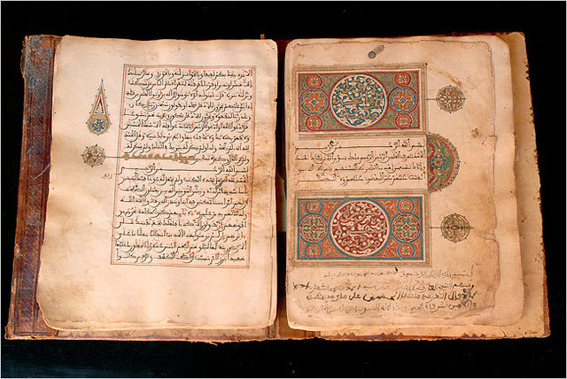
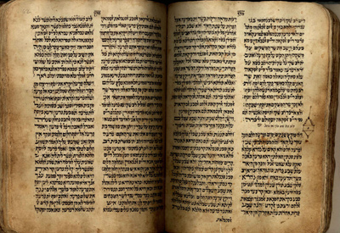
Theory of translation is closely connected with:
Contrastive linguistics
Sociolinguistics
Psycholinguistics
Textual linguistics
Semiotics

Slide 11
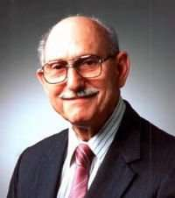
Translation and contrastive linguistics
Contrastive linguistics is a practice-oriented linguistic approach that seeks to describe the differences and similarities between a pair of languages (hence it is occasionally called "differential linguistics"). Introduced by Robert Lado (1915-1995).
Contrastive linguistics, which investigates correlations between functional elements of SL and TL, creates foundation for the theory of translation, but cannot be identified with it.

Slide 12
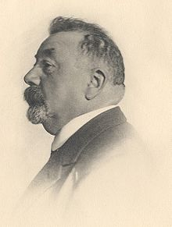
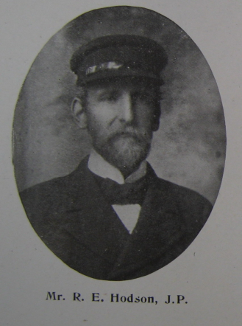
Translation and sociolinguistics
Sociolinguistics is the descriptive study of the effect of society (including cultural norms, expectations, and context) on the way languages used, and the effects of language use on society. Sociolinguistics differs from sociology of language: the focus of sociology of language is the effect of the society on the language, while the sociolinguistics focuses on language's effect on the society.
Introduced by Luis Gauchat (1866-1942) and Thomas Callan Hodson (1871-1953)

Slide 13
Sociolinguistics consider translation as:
reflection of the social world
communicative process which is determined by society
social norms for translation
Translations from other languages have an influence on the norms of TL (for example, vocabulary and phraseology of the biblical translations).

Slide 14
Psycholinguistics and translation
Psycholinguistics is the study of the psychological and neurobiological factors that enable humans to acquire, use, comprehend and produce language. Introduced by Jacob Robert Kantor (1888-1984).
Eugene Nida suggested two schemes of translation:
1. Formal translation (finding equivalent elements in vocabulary, grammar, syntax and phraseology).
2. Conscious / intelligent translation which consists of three stages: analysis of the material, transfer of the material from SL to TL; reconstruction of the material.

Slide 15
analysis reconstruction
transfer
A (source)
B (receptor)
X
Y

Slide 16
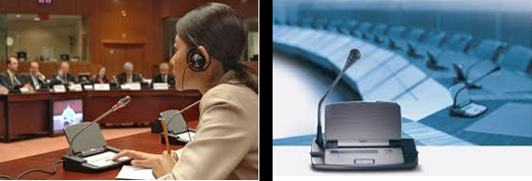

The first type is used in interpreting and simultaneous translation, which are based on the probabilistic prediction of the massage content and the anticipatory synthesis of its equivalent in TL (Г.В. Чернов).
Another important psychological component of translation is the competency of a translator (R. Stolze, W. Wills), which includes his acquaintance with the subject of translation, cultural background, professional terminology both SL and TL.

Slide 17
There is one important advantage for a translator in the case of oral translation: he / she can see and hear both the speaker and the audience; the translator can also perceive paralinguistic elements of the speaker’s speech (changings in tones, gesticulation, facial expression, ironic connotations of voice, specificity of communicative situation).
In the case of writing translation the translator must reconstruct the historical background and communicative situation in his / her imagination. Moreover, it is necessary to adapt the material of translation to the needs of the target (modern) audience.

Slide 18
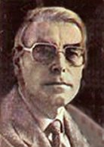
Translation and textual linguistics
Text linguistics is a branch of linguistics that deals with texts as communication systems; it includes the following aspects:
Cohesion
Coherence
Intentionality
Acceptability
Informativity
Situationality
Intertextuality
One of the most famous scholar – Robert Alan de Beaugrande (1946-2008)

Slide 19
Translation and semiotics
Semiotics is the study of meaning-making, the study of sign processes and meaningful communication. This includes the study of signs and sign processes (semiosis), indication, designation, likeness, analogy, metaphor, symbolism, signification, and communication.
Three branches of semiotics:
Semantics: relation between signs and the things to which they refer.
Syntactics: relations among or between signs in formal structures.
Pragmatics: relation between signs and sign-using agents or interpreters.

Slide 20
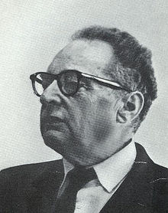
Roman Jacobson’s Theory of translation
Roman Jacobson (1896-1982) was a Russian-American linguist and literary theorist; the pioneer of the structural analysis of language.
The most important essay is “On Linguistic Aspects of Translation” (1959).

Slide 21
The most important aspects of his theory:
Jakobson believes that meaning lies with the signifier and not in the signified. Thus it is the linguistic verbal sign that gives an object its meaning (“there is no signatum without signum”, 1959, p. 232).
Interpretation of a verbal sign according to Roman Jakobson can happen in three ways:
Intralingual (within one language, i.e. rewording or paraphrase)
Interlingual (between two languages)
Intersemiotic (between sign systems)

Slide 22
Intralingual translation
The intralingual translation of a word uses either another, more or less synonymous, word or resorts to a circumlocution. Yet synonymy, as a rule, is not complete equivalence: for example, “every celibate is a bachelor, but not every bachelor is a celibate.” A word or an idiomatic phrase-word, briefly a code-unit of the highest level, may be fully interpreted only by means of an equivalent combination of code-units, i.e., a message referring to this code-unit: “every bachelor is an unmarried man, and every unmarried man is a bachelor,” or “every celibate is bound not to marry, and everyone who is bound not to marry is a celibate.”

Slide 23
Interlingual translation
Likewise, on the level of interlingual translation, there is ordinarily no full equivalence between code-units, while messages may serve as adequate
interpretations of alien code-units or messages. The English word “cheese” cannot be completely identified with its standard Russian heteronym “ сыр,” because cottage cheese is a cheese but not a сыр. Russians say: Принеси сыру и творогу “bring cheese and [sic] cottage cheese.” In standard Russian, the food made of pressed curds is called only if ferment is used.

Slide 24
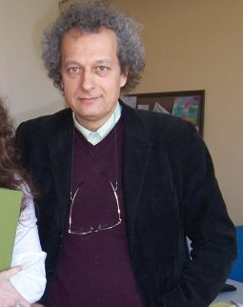
Bruno Osimo (born in 1958)
Bruno Osimo is a follower of Roman Jacobson’s theory of translation whose approach integrates translation activities as a mental process, not only between languages (interlingual translation) but also within the same language (intralinguistic translation) and between verbal and non verbal systems of signs (intersemiotic translation).

Slide 25
A central concept of translation studies described by Bruno Osimo is code-switching, key characteristic of multilingual individuals.
"Translation is the creation of a language of mediation between various cultures. The historic analysis of translation presupposes the readiness of the researcher to interpret the languages of the translators belonging to different ages, and also to interpret their ability to create new languages of mediation (Osimo 2002, Torop 2009). "

Slide 26
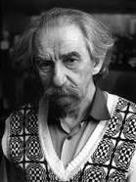
Yuri Lotman (1922-1993)
He developed R. Jacobson concept of language as a code system: the language cannot be considered as only a code, that is an artificial and contractual system which has appeared recently, but Y. Lotman suggests the formula
Language = code + history.
In accordance with R. Jacobson, the aim of intercourse is adequacy of communication.

Slide 27
The abstract model of communication: a structure without memory (1) and with memory (2)
A
B
A
B

Slide 28
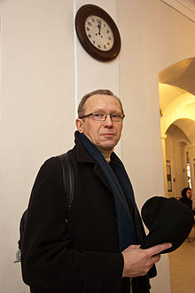
Peeter Torop (born in 1950)
He expanded the scope of the semiotic study of translation to include metatextual, intratextual, intertextual, and extratextual translation and stressing the productivity of the notion of translation in general semiotics.

Slide 29
Torop’s concept of textual translation
“Textual translation“ is a process by which a text is transformed into another text. This term does not make a distinction between interlingual and intralingual translation.
“Metatextual translation“ is a process transferring a text not into another text, but into a culture: in other words.
Sometimes, as P. Torop stresses, textual and metatextual translations are simultaneous, contextual operations: they go together:
“When the translator or the publisher himself prepares the preface, commentary, illustrations, glossaries, and so on to a translated text, it is possible a translation being textual and metatextual at the same time”.

Slide 30
Intertextual translation
In our world, no text rises in autonomy, outside a context. Consequently, when an author writes a text, a part of what he writes is a product of outer influences, while another part is a product of her own personal contemplation.
When an author assimilates material - in an explicit or implicit, conscious or unconscious way -coming from others' texts, he makes an intertextual translation, and the assimilated material is called intertext.
P. Torop makes an important point here: «The author and the translator and the reader all have a textual memory».
If, for example, an author "quotes" a passage by someone else without using quotation marks or other graphic devices to indicate the beginning and end points of the quotations, it is very important for the translator to catch the citation and convey it to the reader of the metatext.

Slide 31
Extratextual translation
Extratextual translation concerns the intersemiotic translation described by R. Jakobson. In it, the original material - prototext - is generally verbal text, while metatext is made, for example, of visual images, still, or moving as in film. It can also work the other way round, with a prototext made of music, images and so on, and a verbal metatext. P. Torop writes:
“Every art's language has its own articulation; its composing elements can be completely different. At the same time, however, natural language can be used as a language to describe all of them (metalanguage). Art criticism is actually a description of visual and linguistic art works by means of the natural language”.

Slide 32
P. Torop’s eight-stages scheme of translation process
adequate translation
recoding |  |  |  | transposition
analysis |  | synthesis |  | analysis |  | synthesis
autonomous | dominant-centered | autonomous | dominant-centered | autonomous | dominant-centered | autonomous | dominant-centered
macro-style 1 | precision 2 | micro-style 3 | quotation 4 | theme 5 | description 6 | expression 7 | freedom 8

Slide 33
The first division concerns recoding and transposition, which distinguishes the transfer of the expression plane (recoding) and the transfer of the content plane (transposition).
1. macro-stylistic translation. In this type of translation, the dominant is the expression plane of the prototext. In the metatext, we observe a compliant preservation of the meter, of the rhymes, of the strophes (if it is a poem), and of every other formal structure.
2. exact translation. Unlike the preceding type, the prototext expression plane dominates to the point that nothing else is left in the metatext.
3. micro-stylistic translation. The main purpose of this type of translation is to recreate the individual expressive devices of the author.
4. quotation translation. In this type of translation, the aim to formally reproduce the expression plane is considered so important that only formal limitations (grammar and syntax) prevent the translator to "copy" the original: lexical precision is the absolute dominant.

Slide 34
5. thematic translation. The expression plane in this case is subject to the content plane. Form is sacrificed in the name of comprehensive content.
6. descriptive translation. Like all autonomous translation types, the prevalence of the dominant is pushed to the extreme, and the possibility of translating the entire text is rationally refused.
7. expressive (or receptive) translation. This type of translation is realized when, in the translator's intentions, the metatext dominant coincides with the metatext expressiveness.
8. free translation and, among those examined in Torop's model, is that which produces a text that differs most from the prototext. It is not a real "translation" as we commonly use the word; we could call it a remake, as are those that are commonly described as "liberally drawn from'", or "liberally inspired to'".

Slide 35
In this course the following topics will be considered:
Equivalence in translation
Different types of translation
Importance of communicative context
Lexical aspects of translation
Grammar aspects of translation
Syntactic aspects of translation
Stages of translation

